Slide 1
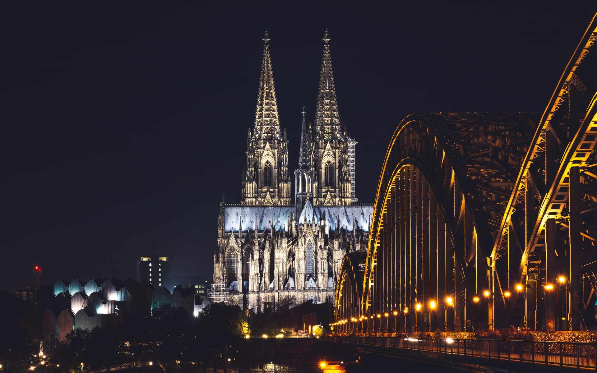
IBM Applied Data Science Capstone
Santhosh Vasudevan

Slide 2

TITLE
Where can be the next Supermarket, Grocery Store in Cologne Germany!!

Slide 3
BUSINESS PROBLEM
FMCG products sell quickly at relatively low cost. The average consumer is common man. Thus this is a huge volume lost cost margin business. Which needs help of analytics to be successful.
OBJECTIVE
To identify and suggest a group of locations in the city Cologne, Germany which can be considered for opening a new Supermarket cum Grocery Store

Slide 4
Data Sources
List of neighborhoods, zip codes, Geospatial coordinates and Population
https://postal-codes.cybo.com/germany/cologne/
GeoJSON data of Cologne City
https://www.offenedaten-koeln.de/dataset/postleitzahlgebiete-koeln
FourSquare API

Slide 5
Methodology
Data Scraping: From the data source website.
Data Cleaning: Converting text form with comma separators, degrees and units information to integer and float format.
Feature Selection: Selecting the right features required for modelling.
Data Exploration: Explore data for understanding demographic informations. Using Folium for geo spatial visualisation. Explore Venue information using Foursquare API
Modelling: Perform K-Means clustering technique on SuperMarket information. Optimize K value using Inertia method.
Visualise: Plot the cluster information and predict the result.

Slide 6
Predictive Modeling
Clustering SuperMarket Information and optimising the best K – Value
K – Vaue 8 shows minimal intra cluster sum of squares error.

Slide 7
Results
Cluster #4 Target Location
Cluster #6 Possible Target
Cluster #8 Possible Target
Clusters and Target colours where next SuperMarket can be planned.

Slide 8
Discussion
Yes there is still room for new Supermarkets and Grocery store in Cologne.
Cluster #4, #6 and #8 are potential locations that has more people to cater to.
Other Clusters may be avoided, for either there are supermarkets already or they have other businesses which wont be interested in buying Supermarket things like Cluster #2 which is a outlier.
Improvements:
More rigor demographics info is required, rental rates needs to be factored, median income of population needs to considered. Foursquare API venue limits and radius limits needs to be removed.

Slide 9
Conclusion
Solution for Business problem is identified.
Suggested Locations based on local knowledge are:
50931 (Lindenthal)
50939 (Klettenberg, Lindenthal)
51105 (Kalk Porz)
50672 (Friesenviertel)
50737 (Nippes)
50739 (Nippes)
51065 (Müllheim)

Slide 10
Thank You

